Slide 1
What can we learn from the VUV spectra of
CH₃OH, CH₃OD, CD₃OH and CD₃OD
recorded 40+ years ago ?
Marc van Hemert
Guest at the Theoretical Chemistry Group
Leiden Institute of Chemistry
Leiden University
February 3 2015 Kasteel Oud Poelgeest

Slide 2
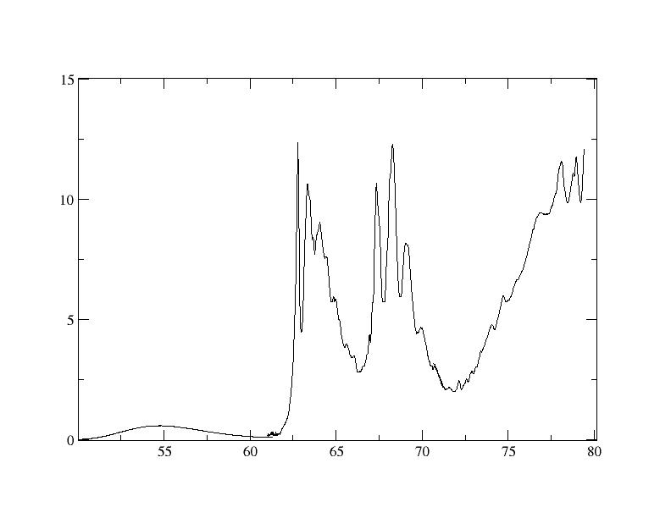
VUV spectrum of CD₃OD dd 1973
σ(Mb)
V
II
III
IV
I
kK

Slide 3
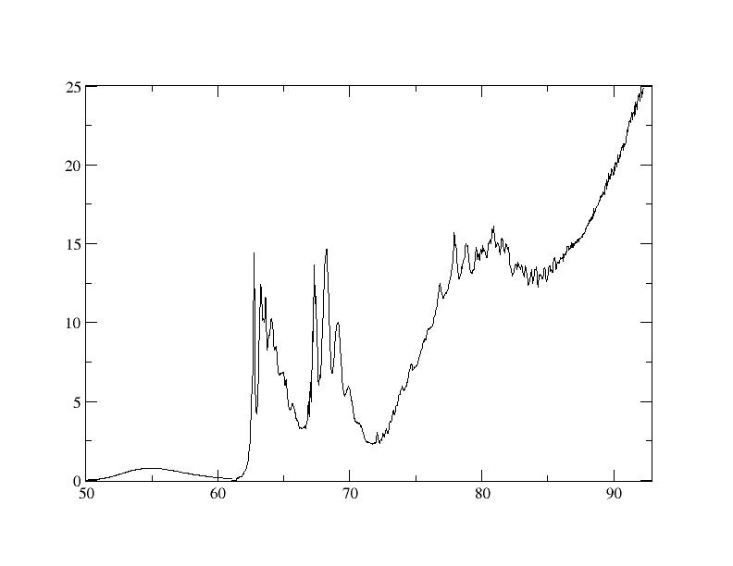
VUV spectrum of CD₃OD dd 2002 (B.-M. Cheng et al.)
σ(Mb)
V
II
IV
III
I
kK

Slide 4
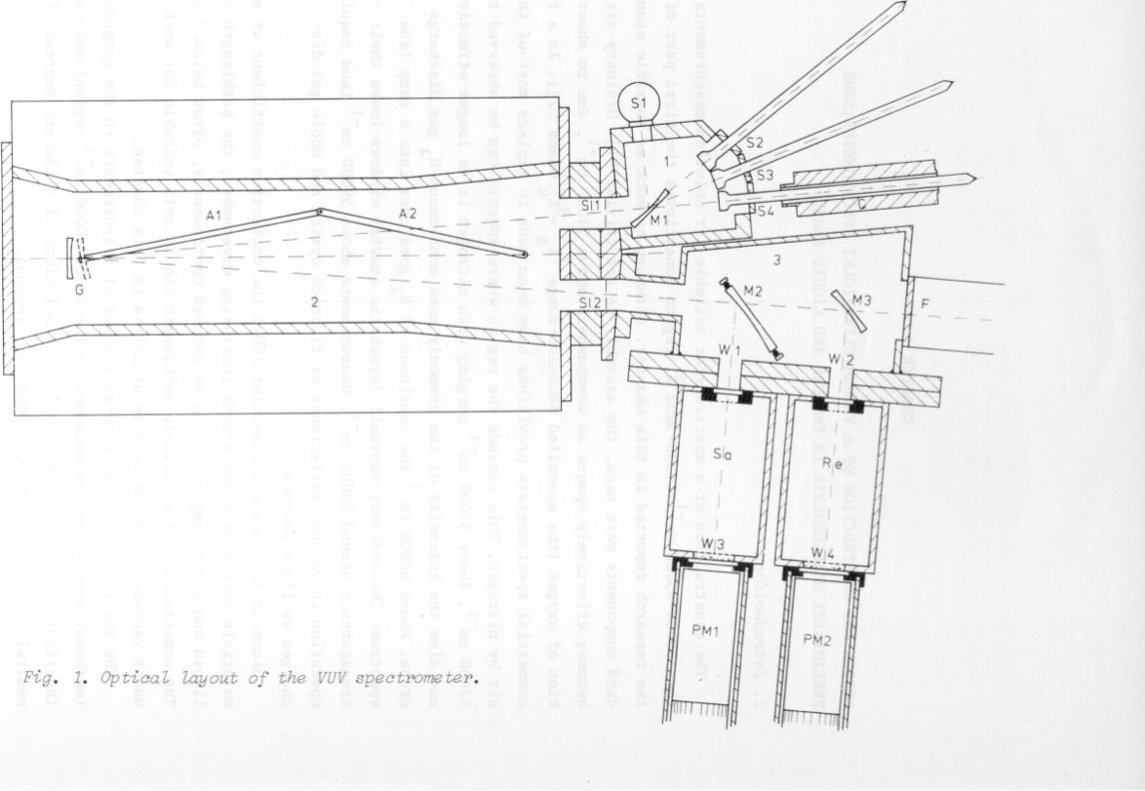
Improved spectra due to:
~ 1970 ~2000
Light sources D₂, Xe,Kr,Ar µdischarge SRRC synchrotron
Monochromator 0.5m Jarrell-Ash Robin 1m Seya-Namioka/
6m cylindrical grating
Pressure gauge Differential oil manometer Baratron
Will use figures based on Cheng’s Epaps data in the remainder. Horizontal axis kK, vertical axis Mb.
(I had to reconstruct the spectra by scanning original recorder traces, processed data got lost, apart from CD₃OD)
The 1970 double beam spectrometer

Slide 5
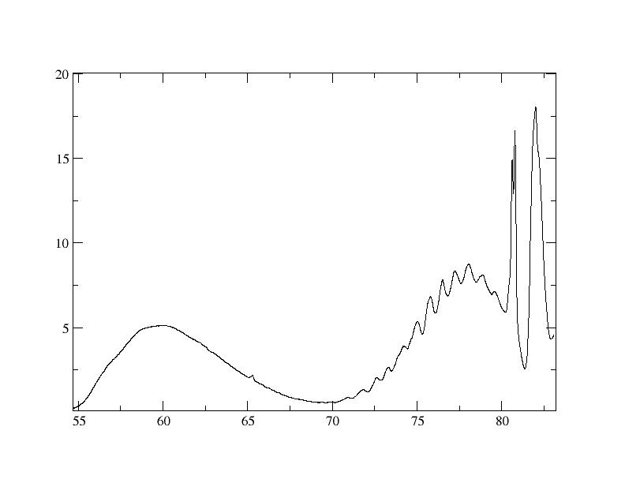
Comparison of the methanol and water spectra
CH₃OH
V
IV
I
II
III
H₂O
Only first bands look similar.
Band IV in CH₃OH looks like H₂O B band
I
Ã
B
C

Slide 6
Water A and B band “completely” understood since work of Rob van Harrevelt (2000-2008)
A Band:
Adiabatic wave packet calculations on single 3D PES from ab initio MRDCI calculations provide:
- Spectra for 3 isotopomers.
- OH/OD branching ratio as function of wavelength.
- OH/OD rovibrational level distribution as function of wavelength.
All in accord with experiment.
B Band:
Non-adiabatic wave packet calculation on coupled PES’s provide:
- Near exact reproduction of experimental spectra when effect of parent.
molecule rotation at room temperature is taken into account.
- OH/OD rovibrational level distribution.
- OH/OD single N propensity quantitative explanation.
OH/OD X to A branching ratio.
OH/H₂ branching ratio

Slide 7
Problems with reduced (3D) dimensionality treatment of CH₃OH
- consider only 3 degrees of freedom: r_{OH}, r_{CO} and γ_{HOC}
- CH₃OH has 14 valence electrons on 6 nuclei, vs water 8 electrons on 3 nuclei
Molpro workhorse fails: No convergence on all parts of the 3D grid when
using one single parameter set for CASSCF and MRCI. It appears impossible
to get a balanced PES.
- Here I will show only 1D curves resulting from Wuppertal-Bonn MRDCI
calculations using the Gamess-UK code.
- 1D curves show already part of the problem (many avoided crossings)

Slide 8
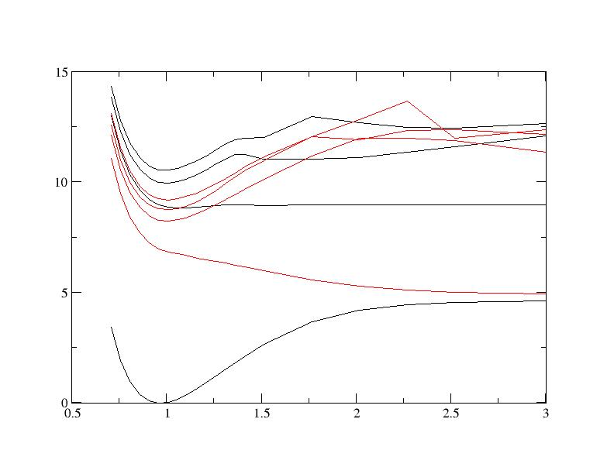
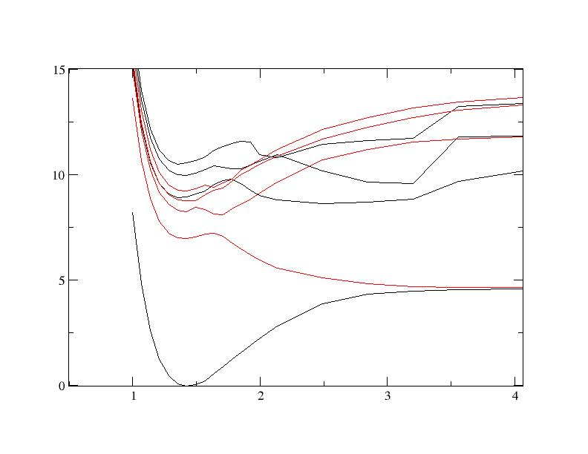
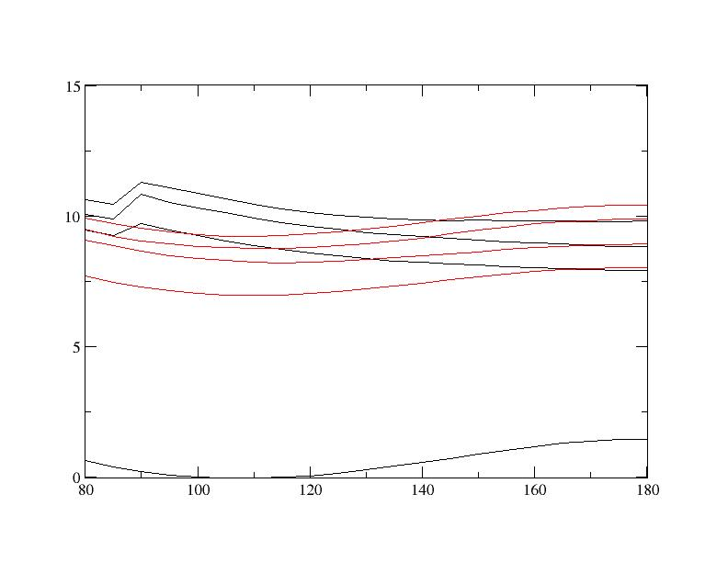
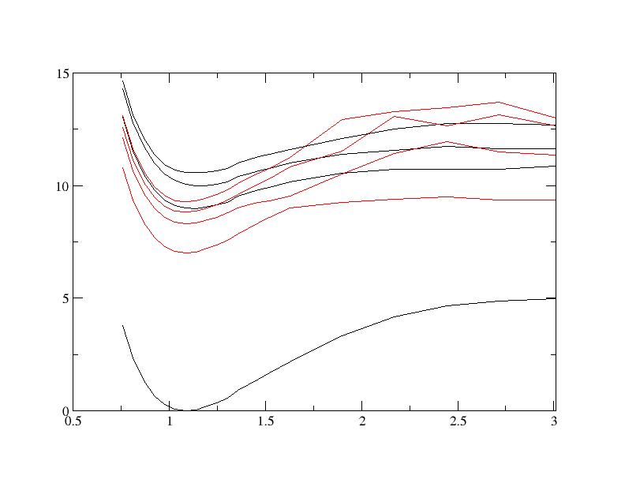
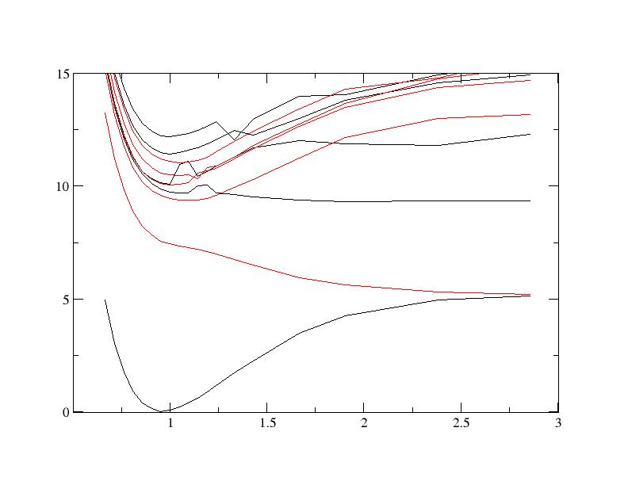
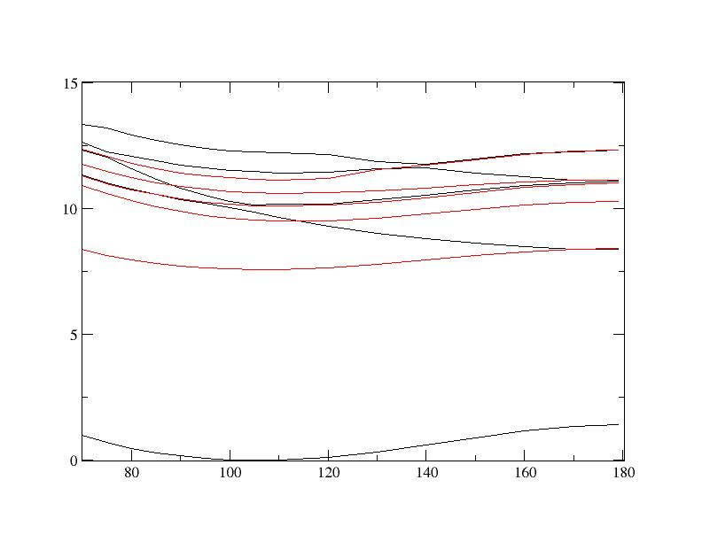
1D pot curves from MRDCI Calculations
CH₃OH
CH₃OH
CH₃OH
r_{OH}
r_{CO}
α_{COH}
A’
A”
CH₃OH
r_{CH}
H₂O
H₂O
r_{OH}
α_{HOH}

Slide 9
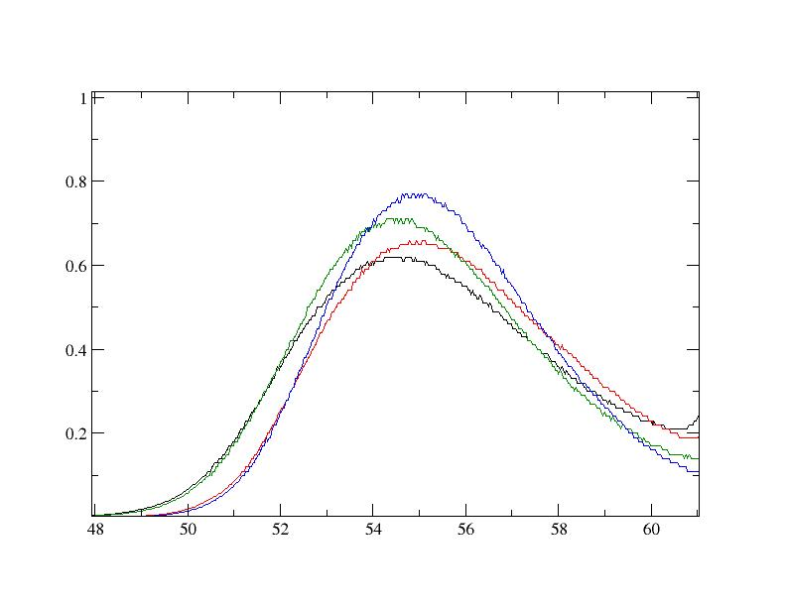
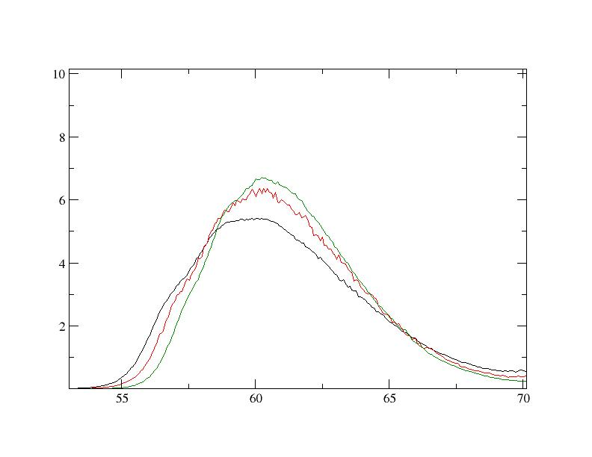
First absorption band
CH₃OH
CH₃OD
CD₃OH
CD₃OD
Water band ~5kK to the blue of CH₃OH band, largely due to difference in ground state CH₃O – H and HO – H dissociation energies.
H₂O HOD
D₂O
Isotope shifts in accord with OH/OD bond breaking (difference in E_{zpt} for OH/OD ~ 500 cm⁻¹).

Slide 10
Harmonic frequencies from B3LYP calculation
CH₃OH CH₃OD CD₃OH CD₃OD CH₃OH
(exp fundamental)
OH/D stretch 1 3856 3107 3856 2807 3684
CH/D stretch 2 3107 3036 2302 2301 2999
9 3036 2991 2253 2253 A” 2967
3 2991 2807 2145 2145 2844
CH/D bend 4 1511 1509 1303 1148 1486
10 1500 1500 1146 1094 A” 1482
5 1481 1481 1088 1085 1455
CH₃-OH/D w. 6 1366 1249 1085 1060 1336
CH₃-OH/D w. 11 1174 1174 995 989 A” 1164
7 1078 1049 905 905 1075
CO stretch 8 1044 865 862 775 1034
Torsion 12 288 229 272 209 A” 209

Slide 11
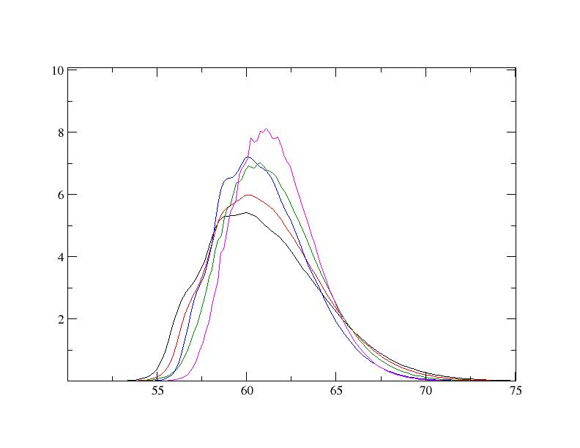
Playing with wave packets
● The 1D curves for the first excited states in CH₃OH and H₂O look rather similar
● We therefore did a 3D wave packet calculation on the water PES for XOH and XOD with X=‘atomic’ CH₃ with mass 15. The water TDMF was used.
● XOH/XOD isotope shift ~ 500 cm⁻¹
● XOH/H₂O peak max ratio 1.35
● CH₃OH/H₂O CAS transition dipole ratio ~ 0.25. Explains ~ order of magnitude smaller cross section for CH₃OH.
● OH/OD bond breaking 100x more probable than CO bond breaking, only due to heavier mass !
H₂O HOD D₂O XOH XOD

Slide 12
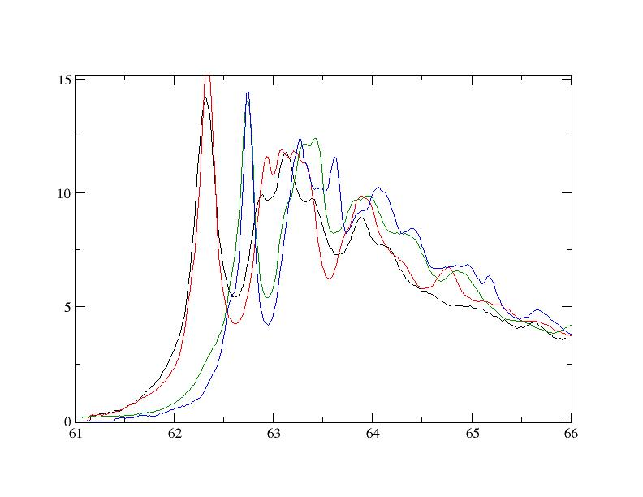
Second absorption band
● No OH/OD isotope shift
● Significant CH₃/CD₃ isotope shift
(400 cm-1)
● Vibrational interval in CH₃OH/D is 800 cm⁻¹, in CD₃OH/D 550 cm⁻¹. In ground state only the CH bend vibrations show a similar ratio (1500 -> 1100 cm⁻¹). Have no 1D HCH curves.
● 157 nm corresponds to 63.7 kK, just in valley of progression, yet 2A” assignment must be true.
● From 1D curves one derives that both O-H/O-D and C-O bond breaking is possible through predissociation. Non-adiabatic effects can be strong.
CH₃OH
CH₃OD
CD₃OH
CD₃OD

Slide 13
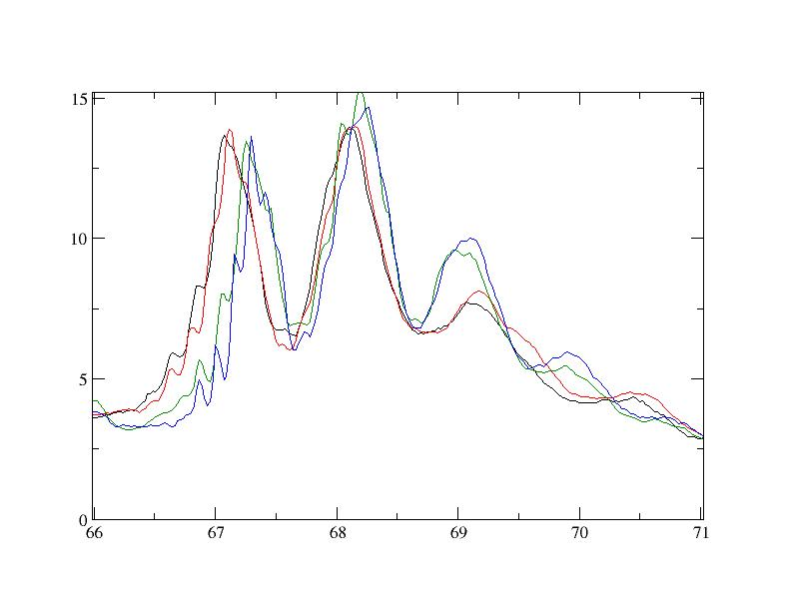
Third absorption band
● As in second absorption band no OH/OD isotope effect
● CH₃/CD₃ isotope shift smaller than in second band. Vibrational intervals for CH₃/CD₃1000 and 850 cm⁻¹, probably wagging motion.
● Strong similarity to second excited state band suggests strong interaction between 2A” and 3A” states, supported by 1D curves.
● Small oscillatory structure of ~175 cm⁻¹ must be excited state torsional motion (shows both CH₃/CD₃ and OH/OD isotope effect)
CH₃OH
CH₃OD
CD₃OH
CD₃OD

Slide 14
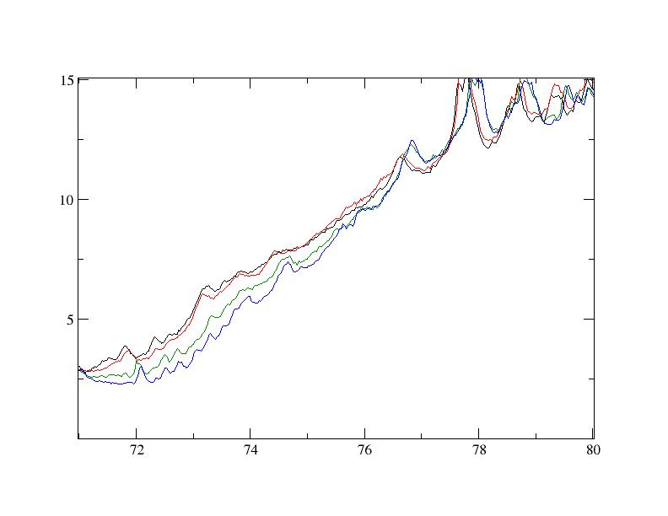
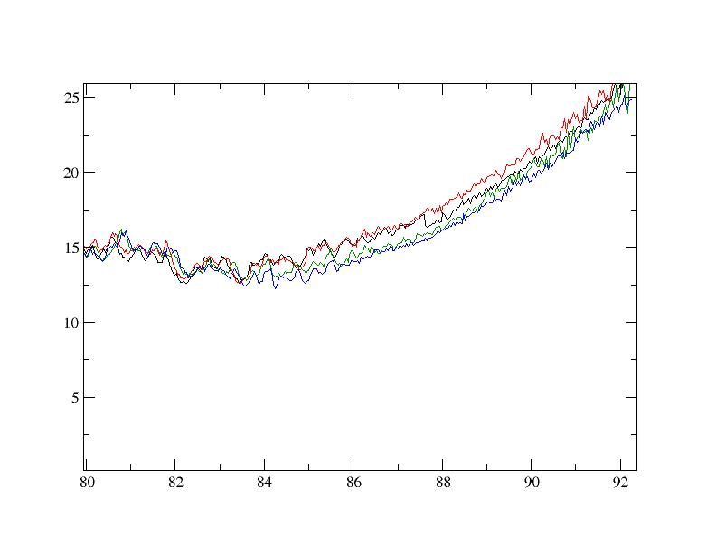
Higher excited states
●The slightly structured slope from 72 to 77 kK shows a resemblance with the water B band structure: resonances washed out by a thermal rotational level population. The state could then be the 2 A’ state where excited CH₃O radicals are formed.
CH₃OH
CH₃OD
CD₃OH
CD₃OD
● The 77 to 80 kK region shows an CH₃/CD₃ isotope effect in the onset of the progression. Remarkably there is little isotope effect in the vibrational intervals of ~1150 cm⁻¹ for all isotopomers
● The region above 80 kK might be equivalent to the first excited state of CH₄ (CH₄(t2) -> C(3s)).
CH₃OH
CH₃OD
CD₃OH
CD₃OD

Slide 15
Concluding remarks
Positive:
● Accurate absorption cross sections available for gasphase CH₃OH, CH₃OD,
CD₃OH and CD₃OD in the 50 to 85 kK (6 to 10.5 eV) region.
● Good interpretation of first absorption band with only O-H/O-D bond breaking
Neutral:
● No narrow absorption peaks: all photon absorption leads to dissociation.
Branching ratios unknown/to be found from experiment
Negative:
● Little help to be expected from Quantum Chemistry + Quantum Dynamics
(Too high dimensional/too complicated potential energy surfaces, too many
avoided crossings)
Extra:
● Condensed phase (liquid) shows 0.5 eV blue shifted maximum at 58 kK with cross section ~ equal to gasphase (path length for T=10% is 3.10⁻⁸ m !)

Slide 17
