Slide 1



Production of vibrationally hot H₂ (v=10–14) from H₂S photolysis
Mingli Niu

Slide 2
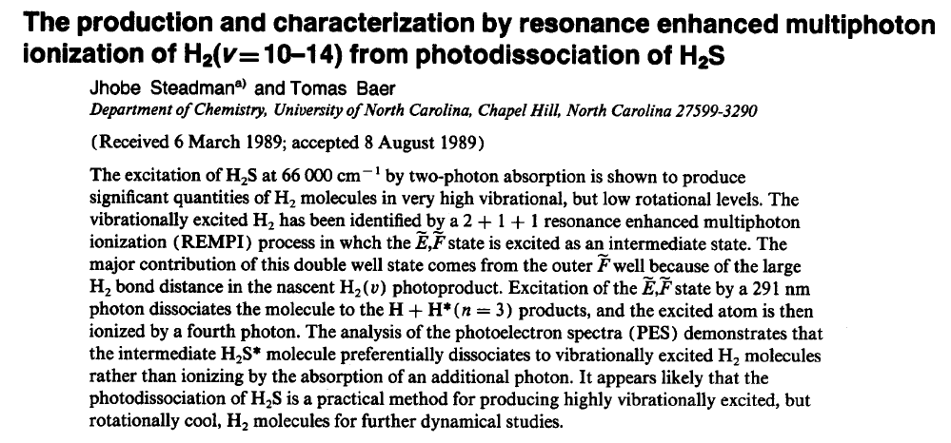
Motivation:
Notes:
The story is start from 1989. Toma Baer found some vibrationally excited H2 from or by using photodissocation process from H2S molecule. They find a series of trantionas from ground state to EF state. We want to comfirm their results.

Slide 3
Motivation:
Controlled preparation of high-v states of H₂
Test of QED in molecules
Test the advanced ab initio calculations of Pachucki & coworkers
Breakthrough in molecular theory (Relativistic effects and QED)

Slide 4
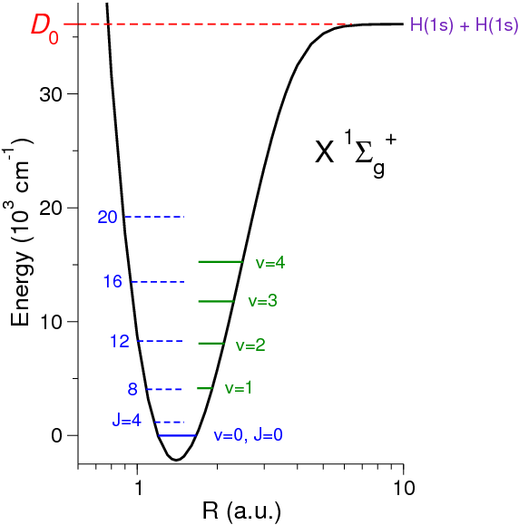
Motivation: Energy contribution of H₂ ground state
nonrelativistic
-0.728 cm⁻¹
E = E_{BO} + E_{ad} + E_{nad}
+ E_{rel} + E_{QED}
J. Komasa,K. Pachucki, et. al. J. Chem. Theory Comput. 7 (2011) 3105.
Notes:
give an impression of the scale of the corrections.
mention the breakthrough of theoretical calculations
Komasa group use full ab-initio calculation
perturb pertur-ba-tive
relativity re-la-ti-vis-tic

Slide 5
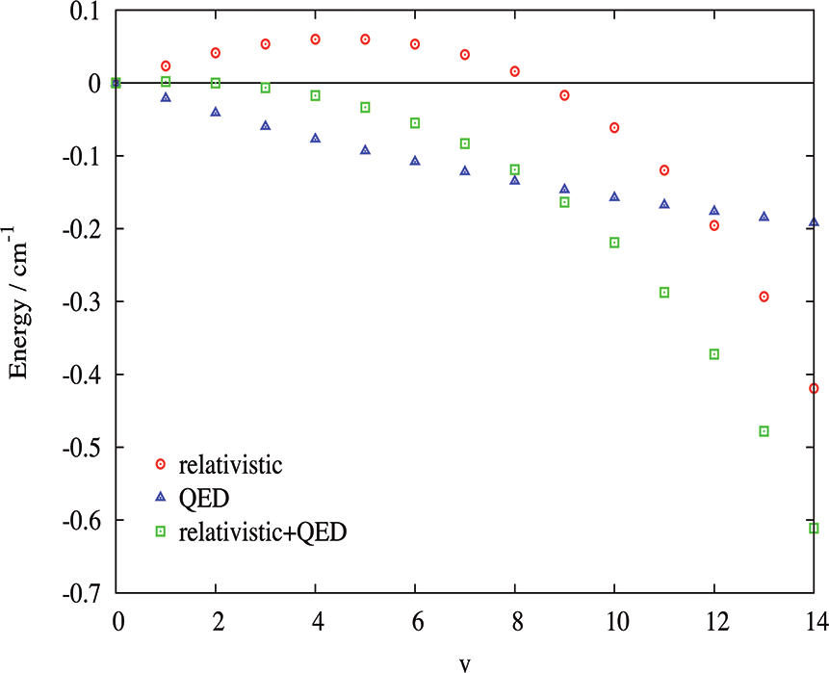
Motivation: variation by the vibrational quantum number v
nonrelativistic
-0.728 cm⁻¹
E = E_{BO} + E_{ad} + E_{nad}
+ E_{rel} + E_{QED}
J. Komasa, et. al. J. Chem. Theory Comput. 7 (2011) 3105.

Slide 6
Test of QED =
Test of the Standard Model
Electromagnetic (QED): D₀ ~ 4.5 eV
Weak < 10⁻¹² eV
Strong < 10⁻⁴⁰⁰ eV
Gravity ~ 10⁻³⁷ eV
Notes:
. Since molecular (and atomic) structure
is dominated by the electromagnetic interaction, with the effects of
the strong-, weak- and gravitational forces many orders of magnitudes
weaker (at least for light systems as hydrogen, where weak
force effects are not yet detectable), any discrepancy between measurements
and theory points to new physics.

Slide 7
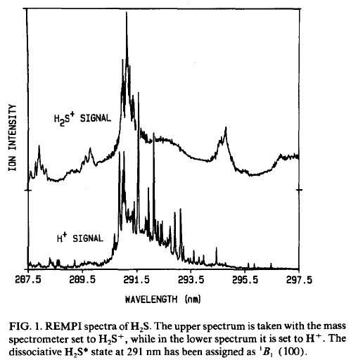
Background
J. Steadman; T. Baer, The Journal of Chemical Physics 1989, 91 (10), 6113-6119

Slide 8
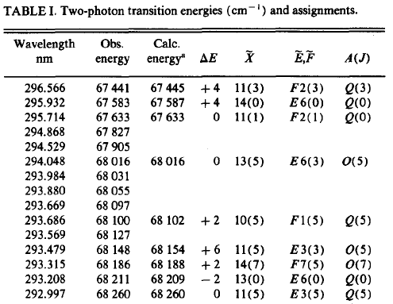
Background
J. Steadman; T. Baer, The Journal of Chemical Physics 1989, 91 (10), 6113-6119

Slide 9
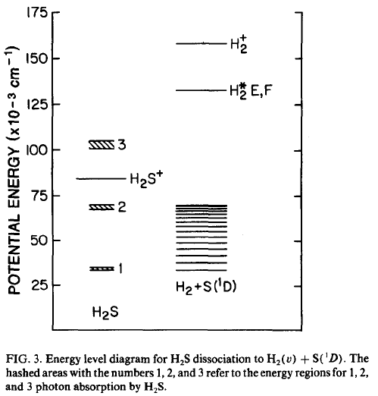
2-photon photolysis of H₂S
H₂+S(¹S)
H₂S
J. Steadman; T. Baer, The Journal of Chemical Physics 1989, 91 (10), 6113-6119
Notes:
The Journal of Chemical Physics 1989, 91 (10), 6113-6119. Steadman, J.; Baer, T.

Slide 10
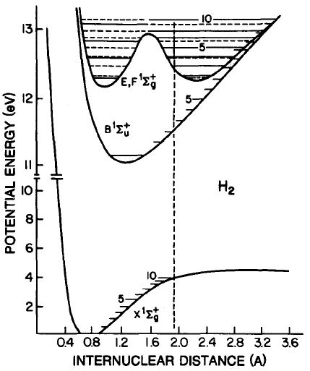
2-photon photolysis of H₂S
H₂
H₂+S(¹S)
H₂S
J. Steadman; T. Baer, The Journal of Chemical Physics 1989, 91 (10), 6113-6119
Notes:
The Journal of Chemical Physics 1989, 91 (10), 6113-6119. Steadman, J.; Baer, T.

Slide 11
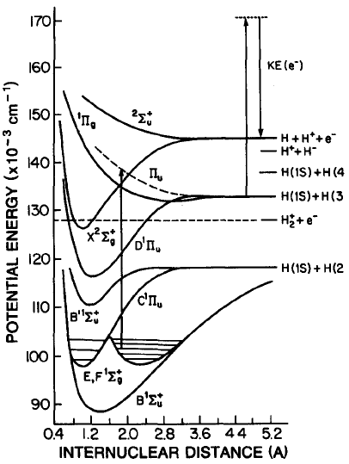
Excitation scheme; multiple photons
J. Steadman; T. Baer, The Journal of Chemical Physics 1989, 91 (10), 6113-6119

Slide 12
Present work: H₂(high-v) from H₂S molecule
H₂(X, v=10-14),
S(¹D)
H₂(EF, v=2-5)
H₂S
J. Steadman; T. Baer, The Journal of Chemical Physics 1989, 91 (10), 6113-6119

Slide 13
Present work: H₂(high-v) from H₂S molecule
Ionization laser
Probe laser
H₂(X, v=10-14),
S(¹D)
H₂(EF, v=2-5)
Production laser
H₂S
J. Steadman; T. Baer, The Journal of Chemical Physics 1989, 91 (10), 6113-6119

Slide 14
Present work: Setup

Slide 15
Present work: Energy scheme

Slide 16
Present work: Energy scheme
206nm

Slide 17
Preliminary results
Overview scan

Slide 18
Preliminary results
Overview scan
X(v=12)-F(v=3) Q1 transition
High-resolution spectrum of H₂ ground state high vibrational quantum number
Notes:
high resolution scan

Slide 19
Preliminary results: summary
H⁺ signal | width/MHz | Ground | Excited | A(J) | Theory | diff
68582.087 | 3754 | 11(3) | F2(3) | Q(3) | 68582.098 | -0.011
68259.287 | 2344 | 11(5) | F2(5) | Q(5) | 68259.321 | -0.034
68490.737 | 1364 | 10(6) | F1(6) | Q(6) | 68490.755 | -0.019
68476.040 | 3399 | 12(0) | F3(0) | Q(0) | 68476.054 | -0.014
68446.270 | 3030 | 12(1) | F3(1) | Q(1) | 68446.288 | -0.018
68387.658 | 3056 | 12(2) | F3(2) | Q(2) | 68387.666 | -0.008
68302.019 | 3526 | 12(3) | F3(3) | Q(3) | 68302.028 | -0.009
68505.510 | 7500 | 12(1) | F3(3) | S(1) | 68505.513 | -0.003
68699.793 | 1243 | 11(4) | E1(4) | Q(4) | 68700.929 | -1.136
68713.986 | 2826 | 13(2) | E2(4) | S(2) | 68716.817 | -2.831
68451.180 | 1256 | 10(10) | E0(10) | Q(10) | 68451.539 | -0.360
68517.165 | 3834 | 13(4) | E2(4) | Q(4) | 68516.334 | 0.830
68411.626 | 2553 | 11(5) | F2(7) | S(5) | 68411.045 | 0.582

Slide 20
Preliminary results: summary
H⁺ signal | width/MHz | Ground | Excited | A(J) | Theory | diff
68582.087 | 3754 | 11(3) | F2(3) | Q(3) | 68582.098 | -0.011
68259.287 | 2344 | 11(5) | F2(5) | Q(5) | 68259.321 | -0.034
68490.737 | 1364 | 10(6) | F1(6) | Q(6) | 68490.755 | -0.019
68476.040 | 3399 | 12(0) | F3(0) | Q(0) | 68476.054 | -0.014
68446.270 | 3030 | 12(1) | F3(1) | Q(1) | 68446.288 | -0.018
68387.658 | 3056 | 12(2) | F3(2) | Q(2) | 68387.666 | -0.008
68302.019 | 3526 | 12(3) | F3(3) | Q(3) | 68302.028 | -0.009
68505.510 | 7500 | 12(1) | F3(3) | S(1) | 68505.513 | -0.003
68699.793 | 1243 | 11(4) | E1(4) | Q(4) | 68700.929 | -1.136
68713.986 | 2826 | 13(2) | E2(4) | S(2) | 68716.817 | -2.831
68451.180 | 1256 | 10(10) | E0(10) | Q(10) | 68451.539 | -0.360
68517.165 | 3834 | 13(4) | E2(4) | Q(4) | 68516.334 | 0.830
68411.626 | 2553 | 11(5) | F2(7) | S(5) | 68411.045 | 0.582

Slide 21
Preliminary results: X(v=12) - F(v=3)
D. Bailly, et. al. Molecular Physics 2010, 108 (7-9), 827-846.
J. Komasa, et. al. J. Chem. Theory Comput. 7 (2011) 3105.
Notes:
better than the theory
No stark correction
combination different -0.0056

Slide 22
Preliminary results: X(v=12) - F(v=3)
Expected accuracy: 0.002 cm⁻¹
Theory: 0.0045 cm⁻¹
D. Bailly, et. al. Molecular Physics 2010, 108 (7-9), 827-846.
J. Komasa, et. al. J. Chem. Theory Comput. 7 (2011) 3105.
Notes:
better than the theory
No stark correction
combination different -0.0056

Slide 23
Conclusions and outlook
Comfirm the previous work and reassign the transitions
High resolution spectroscopy of high vibrational state of H₂ by photodissociation H₂S molecule
Test of QED theory of ground state vibrational level energies to v=12
Improve the S/N ratio
Assign the unknown transitions
Extend to the highest vibrational state (v=14)

Slide 24
Is H₂O has the same phenomenon?

Slide 25


Thanks for your attention!
Questions?
Edcel Salumbides
Wim Ubachs

Slide 26
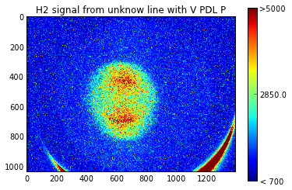
Preliminary results: Imaging
linearly polarized laser E field
molecular beam

Slide 27
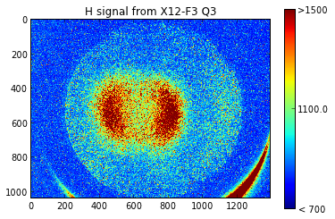
Preliminary results: Imaging
linearly polarized laser E field
molecular beam

Slide 28
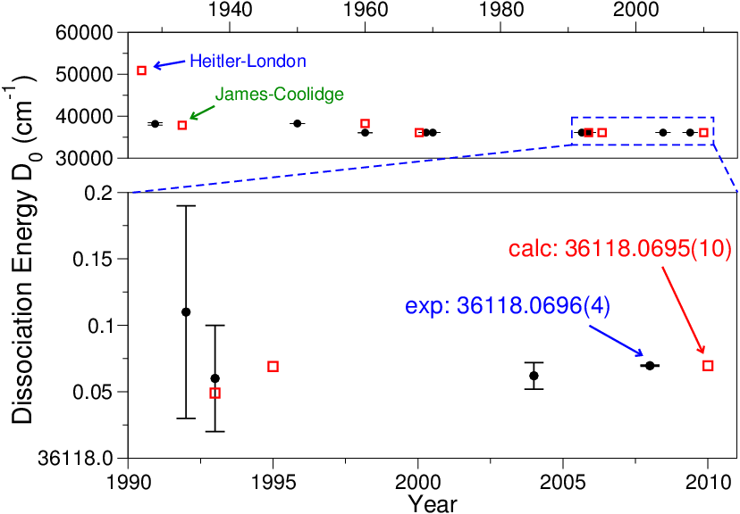
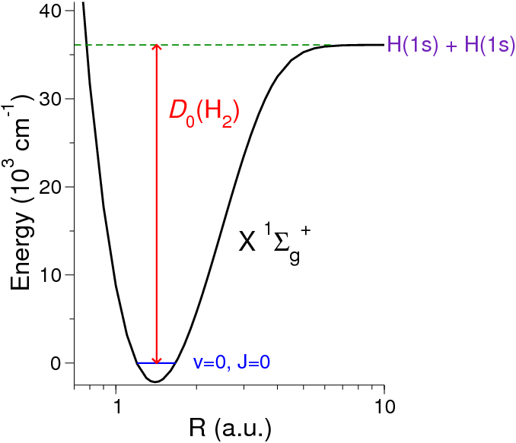
H₂ dissociation energy
Experiment: Liu et al., J. Chem. Phys. 130, 174306 (2009)
Calculation: Piszczatowski et al., J. Chem. Theory Comput. 5, 3039 (2009)

Slide 29
Motivation: variation by the vibrational quantum number v
nonrelativistic
-0.728 cm⁻¹
E = E_{BO} + E_{ad} + E_{nad}
+ E_{rel} + E_{QED}
J. Komasa, et. al. J. Chem. Theory Comput. 7 (2011) 3105.

Slide 30
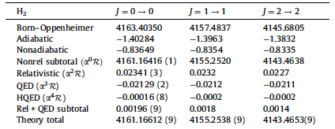
Motivation: QED theory
Test of Quantum electrodynamics(QED) theory in Bond state.
J. Komasa, et. al. J. Chem. Theory Comput. 7 (2011) 3105.
Notes:
Free-particle QED
electron anomalous magnetic moment : PRL 100, 120801 (2008)
exp-theory : 7.7 x 10⁻¹⁰ ( α from PRL 106, 080801 (2011) )

Slide 31
QED: most accurate theory
QED calculations:
Corrections scale to ( Zα ) → power series expansion in ( α )^{n} or 1/( Zα )^{n}
with proton number Z and fine structure constant α
Free-particle QED
electron anomalous magnetic moment : PRL 100, 120801 (2008)
exp-theory : 7.7 x 10⁻¹⁰ ( α from PRL 106, 080801 (2011) )
Bound state QED
Hydrogen atom; Hydrogen-like Uranium ion (U⁹¹⁺)
Helium atom: Kandula, PRL 10, 063001 (2010); van Rooij, Science 333, 196 (2011)
HD⁺ molecular ion: J. Koelemeij poster
Hydrogen molecule: this talk

Slide 32
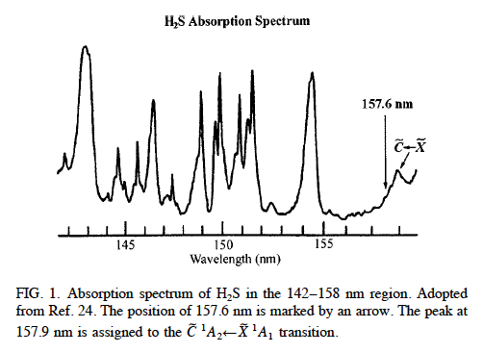
Background
Notes:
J. Chem. Phys. 111, 3940(1999), X,Liu.

Slide 33
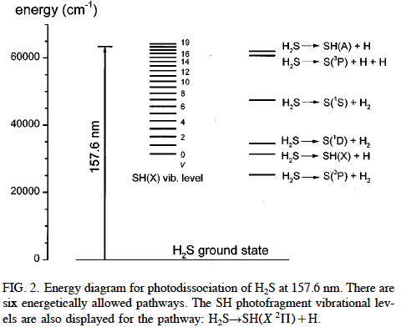
Background
Notes:
J. Chem. Phys. 111, 3940(1999), X,Liu.

Slide 34
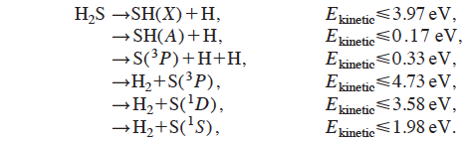
Notes:
J. Chem. Phys. 111, 3940(1999), X,Liu.

Slide 35
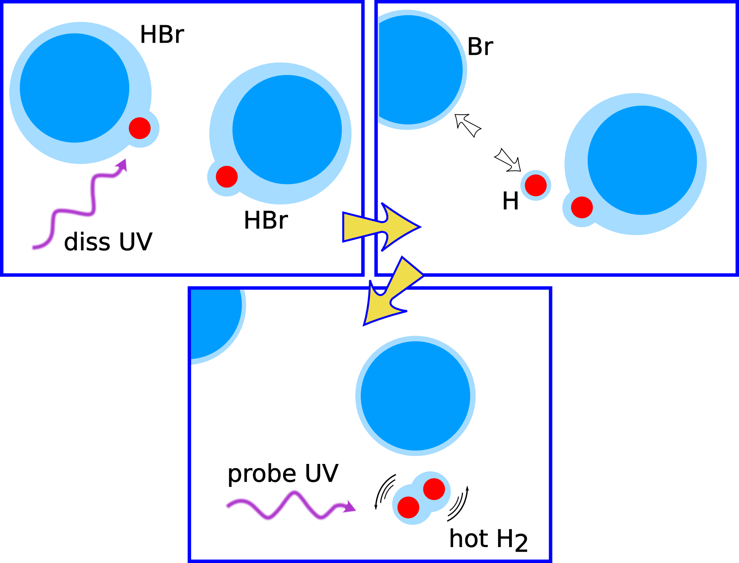
Results: high-J states in X¹Σ_{g}⁺, v=0 of H₂ molecule
Uncertainty estimate (MHz)
Line fitting 5
Residual Doppler <1
I₂ calibration 5
etalon nonlinearity 5
ac-Stark shift 50
dc-Stark shift 10
PDA chirp 150
Statistical 30
Total 160
or 0.005 cm⁻¹
or relative uncertainty 5 x 10⁻⁸
J_{max} (v=0) = 8
T_{equiv} = 12,000 K
E.J. Salumbides, et. al. Phys. Rev. Lett. 107, 043005 (2011)

Slide 36
Results: low-v in X¹Σ_{g}⁺ state of Hydrogen molecule
Uncertainty estimate (MHz)
Ac-Stark < 0. 4
Dc-Stark < 0. 1
Frequency chirp 2.0
Frequency calibration 0.1
Residual 1st-order Doppler H2 0.5
HD 0.3
D2 0.3
2nd-order Doppler < 0. 1
Pressure shift < 0. 1
Statistics H2 1.5
HD 1.6
D2 1.9
Total Uncertainty H2 2.6
HD 2.6
D2 2.8
M. Niu, et. al. J. Mol. Spectr. 300, 44-54 (2014)
G.D. Dickenson, et. al. Phys. Rev. Lett. 110, 193601 (2013)

Slide 37
Preliminary results
Determine energies of X highly vibrational quantum states
D. Bailly, et. al. Molecular Physics 2010, 108 (7-9), 827-846.
J. Komasa, et. al. J. Chem. Theory Comput. 7 (2011) 3105.

Slide 38
Some results:
Two color scan

Slide 39
Some results: X12-F3 Q2

Slide 40
Some results: X11-F2 Q3

Slide 41
X12-F3 Q1

Slide 42
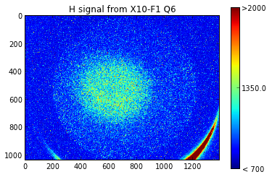

Slide 43
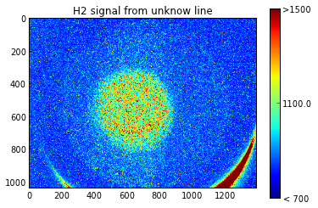

Slide 44
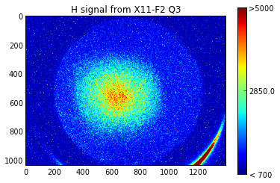
Some results: Image

Slide 45
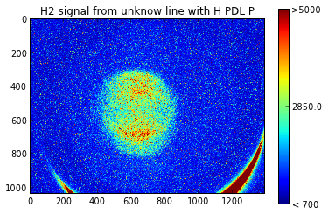
Some results: Image

Slide 46
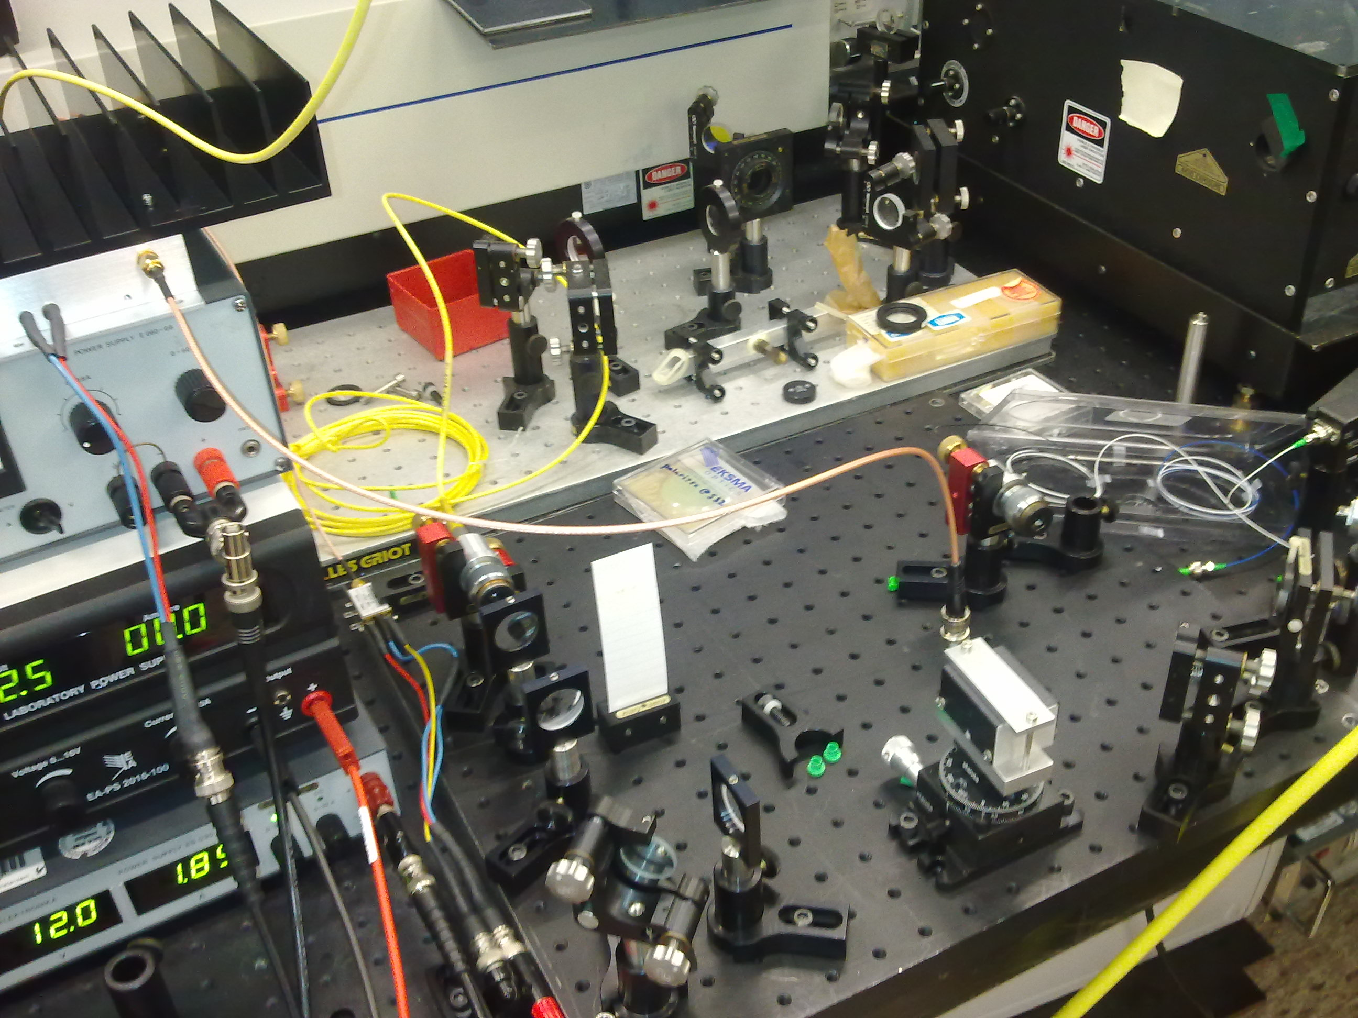
Experiment: Chirp
High power amplifier
Fiber link
and coupler
Voltage controlled
oscillator
Acousto-optic
modulator(AOM)

Slide 47
Experiment:
Matlab program for chirp
M. S. Fee, et. al. Physical Review A 1992, 45 (7), 4911-4924.
K. S. E. Eikema, et. al. Physical Review A 1997, 55 (3), 1866-1884.

Slide 48
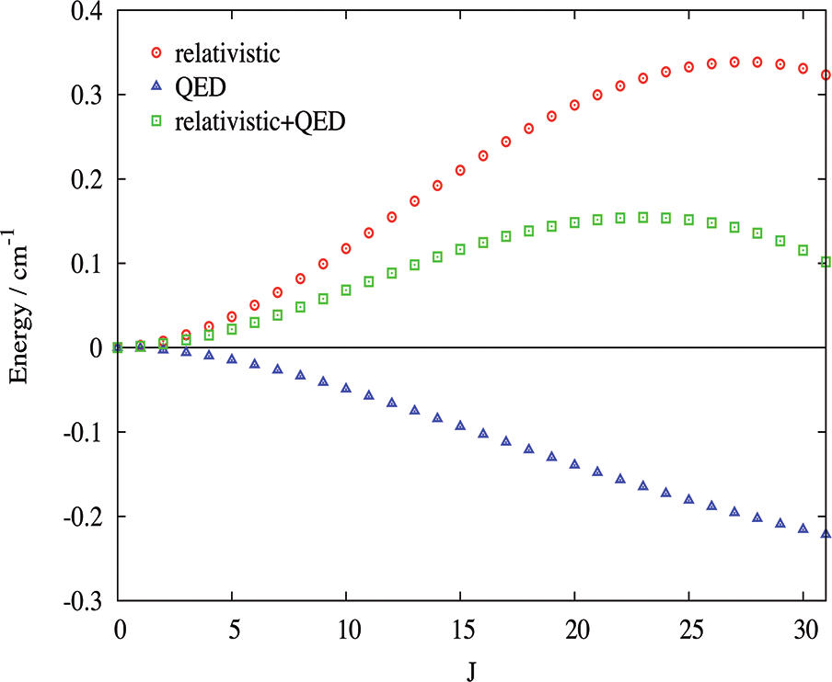
Motivation: variation by the rotational quantum number J
nonrelativistic
-0.728 cm⁻¹
E = E_{BO} + E_{ad} + E_{nad}
+ E_{rel} + E_{QED}
J. Komasa, et. al. J. Chem. Theory Comput. 7 (2011) 3105.

Slide 49
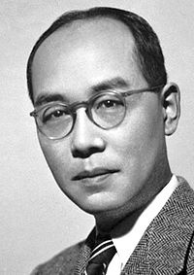
Fifth-force search
Extra hadron-hadron interaction
Yukawa potential (Phenomenological)
strength:
range:
Insert in molecular wave function
Hideki Yukawa
Notes:
different energy shift on the energy level difference between two states.
expectation value
differential effect

Slide 50
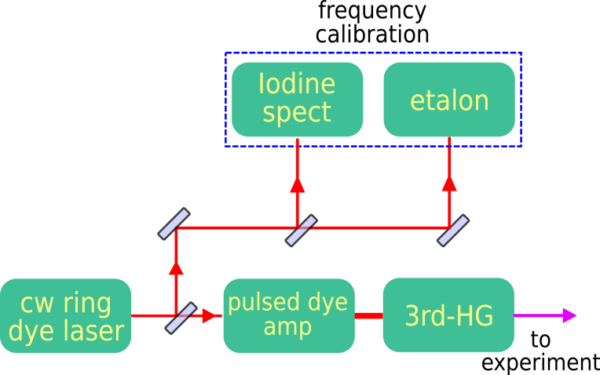
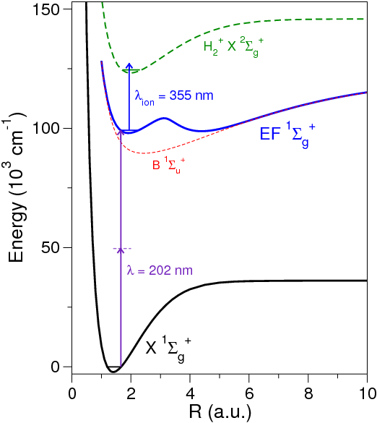
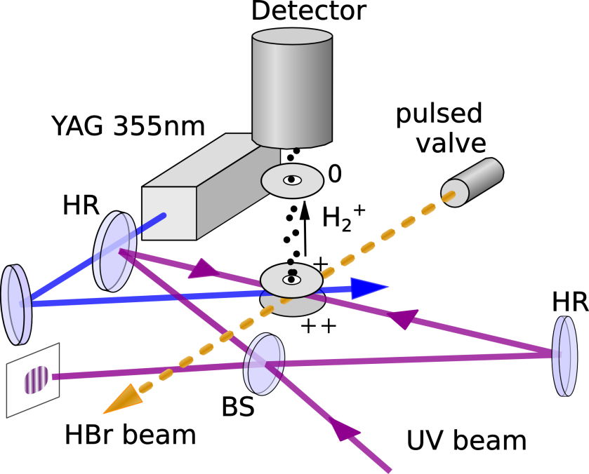
How do we measure?

Slide 51
Results: high-J states in X¹Σ_{g}⁺, v=0 of H₂ molecule
J_{max} (v=0) = 8
T_{equiv} = 12,000 K
E.J. Salumbides, et. al. Phys. Rev. Lett. 107, 043005 (2011)

Slide 52
Results: high-J states in X¹Σ_{g}⁺, v=0 of H₂ molecule
Uncertainty estimate (MHz)
Line fitting 5
Residual Doppler <1
I₂ calibration 5
etalon nonlinearity 5
ac-Stark shift 50
dc-Stark shift 10
PDA chirp 150
Statistical 30
Total 160
or 0.005 cm⁻¹
or relative uncertainty 5 x 10⁻⁸
J_{max} (v=0) = 8
T_{equiv} = 12,000 K
E.J. Salumbides, et. al. Phys. Rev. Lett. 107, 043005 (2011)

Slide 53
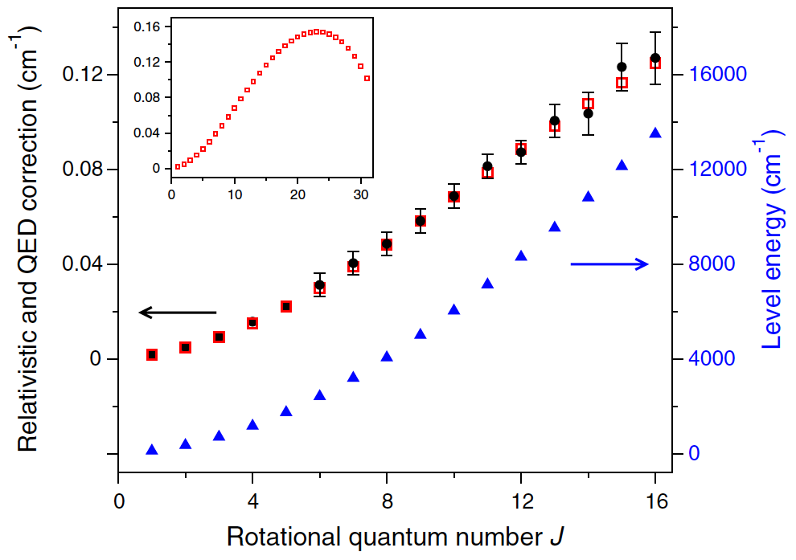
Results: high-J states in X¹Σ_{g}⁺, v=0 of H₂ molecule
Determine energies of X, v=0 rotational quantum states
E.J. Salumbides, et. al. Phys. Rev. Lett. 107, 043005 (2011)

Slide 54
Results: fundamental vibrational splitting in X¹Σ_{g}⁺ state of Hydrogen molecule
M. Niu, et. al. J. Mol. Spectr. 300, 44-54 (2014)
G.D. Dickenson, et. al. Phys. Rev. Lett. 110, 193601 (2013)
Notes:
mention the discharge valve

Slide 55
Results: fundamental vibrational splitting in X¹Σ_{g}⁺ state of Hydrogen molecule
Uncertainty estimate (MHz)
AC-Stark < 0. 4
DC-Stark < 0. 1
Frequency chirp 2.0
Frequency calibration 0.1
Residual 1st-order Doppler H2 0.5
HD 0.3
D2 0.3
2nd-order Doppler < 0. 1
Pressure shift < 0. 1
Statistics H2 1.5
HD 1.6
D2 1.9
Total Uncertainty H2 2.6
HD 2.6
D2 2.8
or relative uncertainty 1 x 10⁻⁹
M. Niu, et. al. J. Mol. Spectr. 300, 44-54 (2014)
G.D. Dickenson, et. al. Phys. Rev. Lett. 110, 193601 (2013)

Slide 56
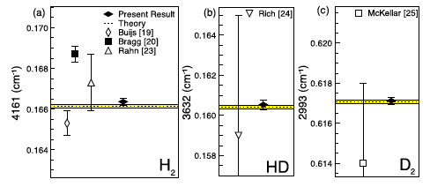
Results: fundamental vibrational splitting in X¹Σ_{g}⁺ state of Hydrogen molecule
Determine energy of on fundamental ground state vibration band (v = 0-1)
M. Niu, et. al. J. Mol. Spectr. 300, 44-54 (2014)
G.D. Dickenson, et. al. Phys. Rev. Lett. 110, 193601 (2013)

Slide 57
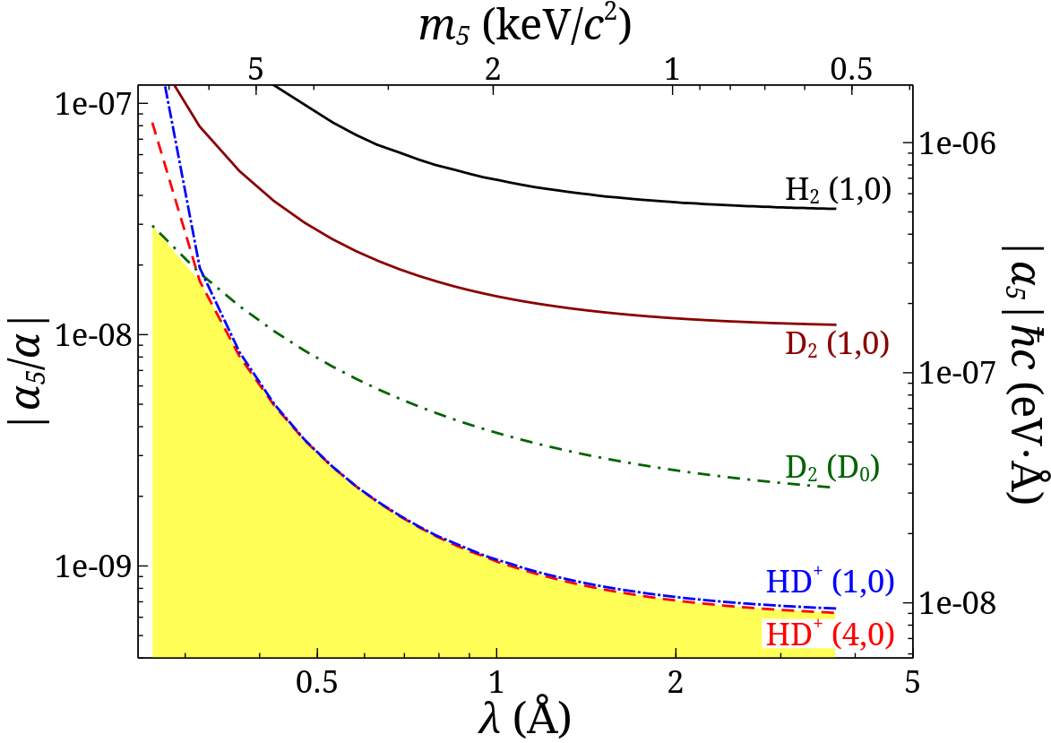
Fifth force constraints:
Phys Rev D 87, 112008 (2013).
EJS, Koelemeij, Komasa, Pachucki, Eikema, Ubachs, Phys Rev D 87, 112008 (2013).
Notes:
An upper bound for the interaction strength a5 can be be obtained
from the combined experimental–theoretical uncertainty
dE for a particular transition by the relation a5 < dE=ðN1N2DYkÞ
mention that the highly vibrational state will be more sensitive to the a5 than the HD+, although HD+ now is the most accurate measurement.
stringent

Slide 58
Preliminary results
D. Bailly, et. al. Molecular Physics 2010, 108 (7-9), 827-846.
J. Komasa, et. al. J. Chem. Theory Comput. 7 (2011) 3105.
Notes:
better than the theory
No stark correction
combination different -0.0056

